Slide 1


Single-cell immune profiling reveals potent anti-tumor immune response in virus-like particle vaccine and anti-CTLA4 treatment through lymphatic delivery
Wendao Liu
Advisor: Zhongming Zhao
QS seminar
8/25/2025

Slide 2
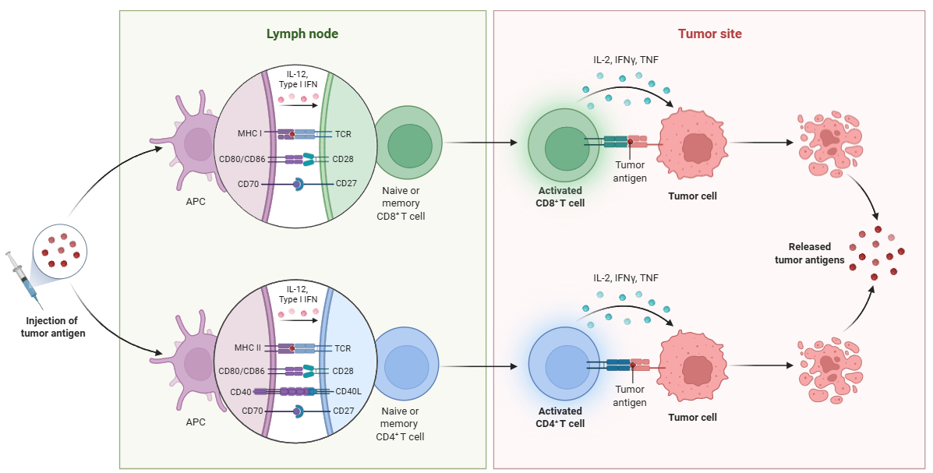
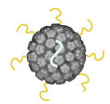
Immune checkpoint blockade and cancer vaccine
Background
Immune checkpoint blockade (ICB, anti-PD1, anti-CTLA4, etc) is a widely used immunotherapy to activate T cells in cancer treatment
ICB also activates bystander T cells recognizing cancer-irrelevant antigens, leading to side effect, immune-related adverse events (irAEs).
Cancer vaccines induce tumor-specific T cell response, and can be combined with ICB
In this study, we used virus-like particle vaccine (VLP, Bacteriophage Qβ conjugated to PMEL peptide, a tumor-associated antigen for melanoma) to treat melanoma
Tumor antigen
Qβ
BioRender.com

Slide 3
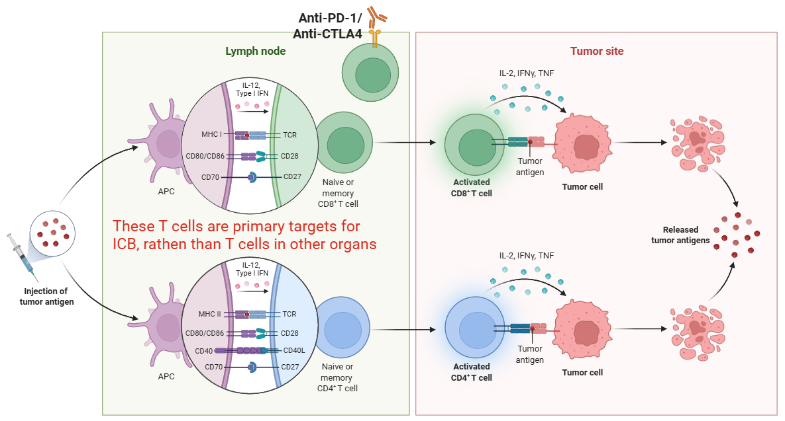
Lymphatic delivery
Background
Immune checkpoint inhibitors were generally administrated intravenously (IV), circulating over whole body, causing irAEs in various organs
We hypothesize that intradermally (ID) lymphatic delivery of αCTLA4 to a vaccinated, non-tumor draining LNs (non-tdLNs) will
increase tumor-specific T cells
minimize bystander T cell infiltration into normal tissues causing irAEs
BioRender.com

Slide 4
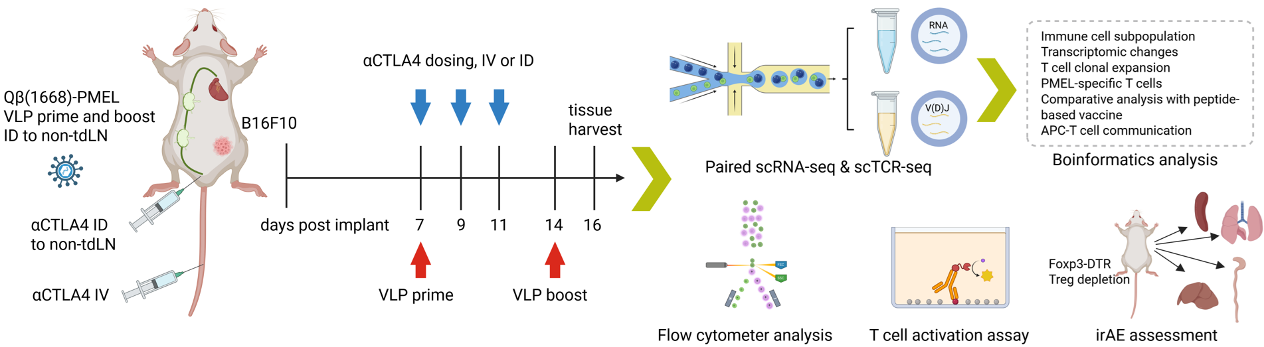
Characterizing immune response in therapies
Design
Mouse melanoma models treated with different therapies:
Aiming to dissect the treatment effect of therapies
 | No αCTLA4 | αCTLA4 IV (blood delivery) | αCTLA4 ID (lymphatic delivery)
No vaccination | N=3 | N=3 | N=3
VLP vaccination | N=3 | N=3 | N=5

Slide 5
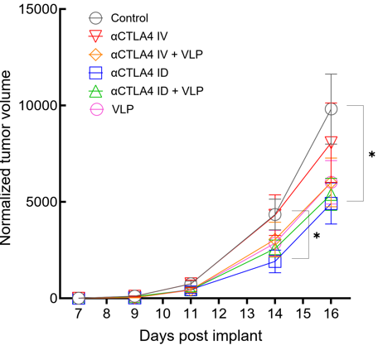
Treatments suppress tumor growth
Results
αCTLA4 administrated at low dose (1 mg/kg, lower than regular 10 mg/kg in mouse experiments) to collect enough tumor tissue for sequencing
VLP vaccination, αCTLA ID treatment, and combination therapy all reduce tumor volume
Compared to control
Compared to αCTLA IV

Slide 6
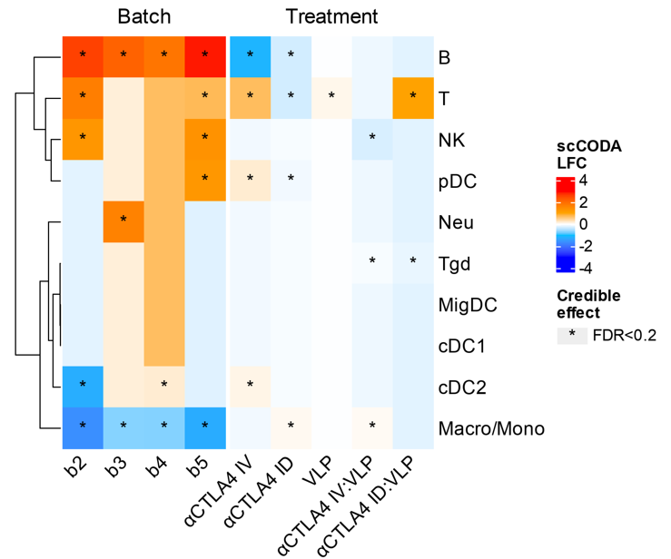
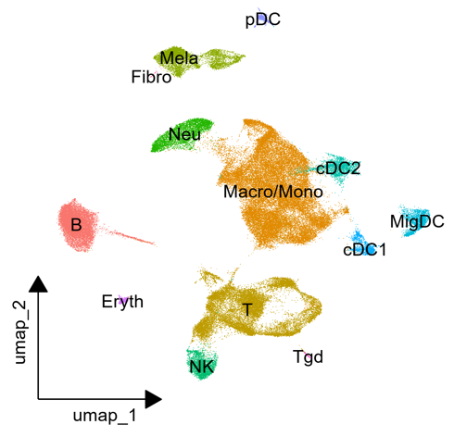
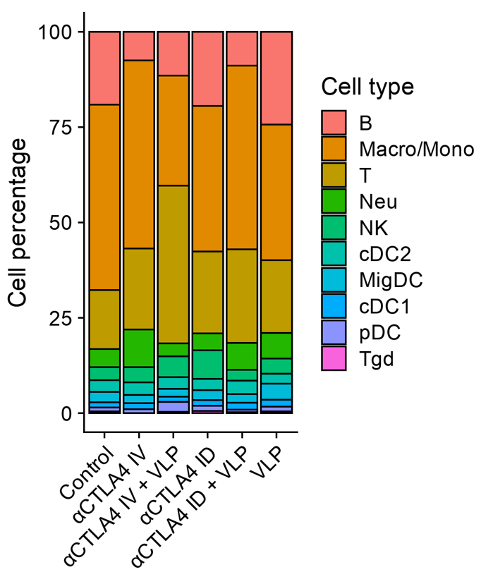
scRNA-seq of immune cells
Results
Clustering and annotation of tumor-infiltrating immune cell populations
Disentangle treatment effects from batch variation using scCODA
Increased T cell proportion is a synergistic effect of VLP vaccination and αCTLA ID (lymphatic delivery)
Buttner M et al. Nat Commn 2021

Slide 7
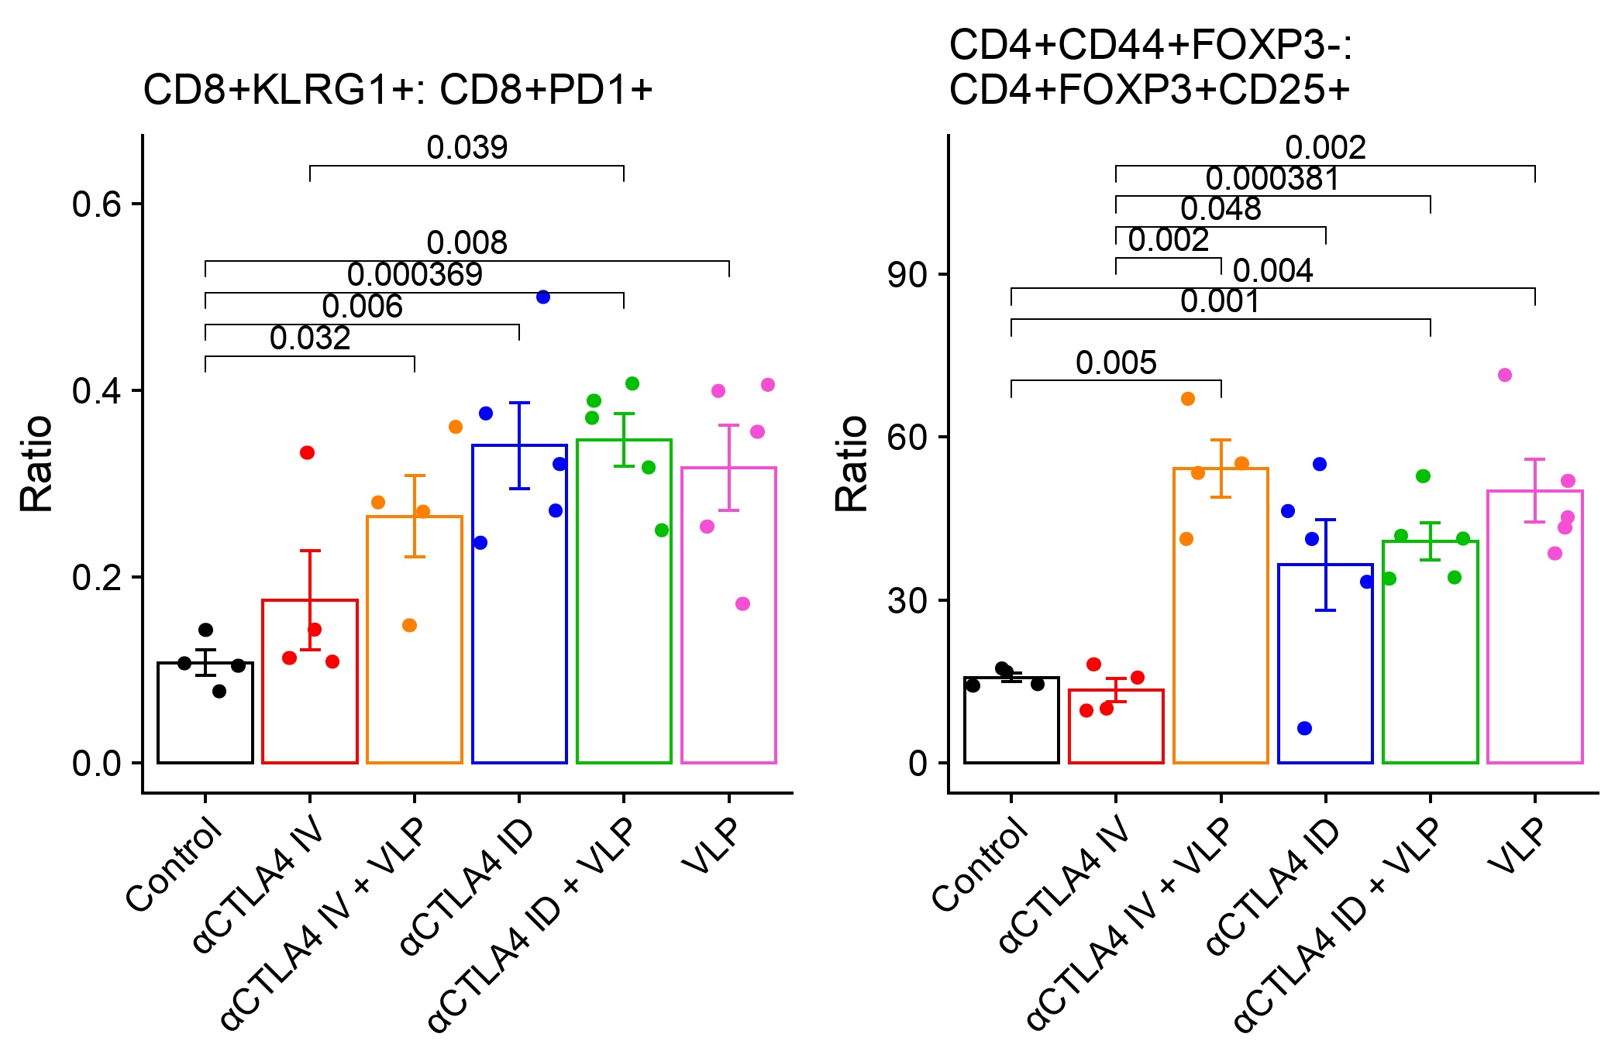
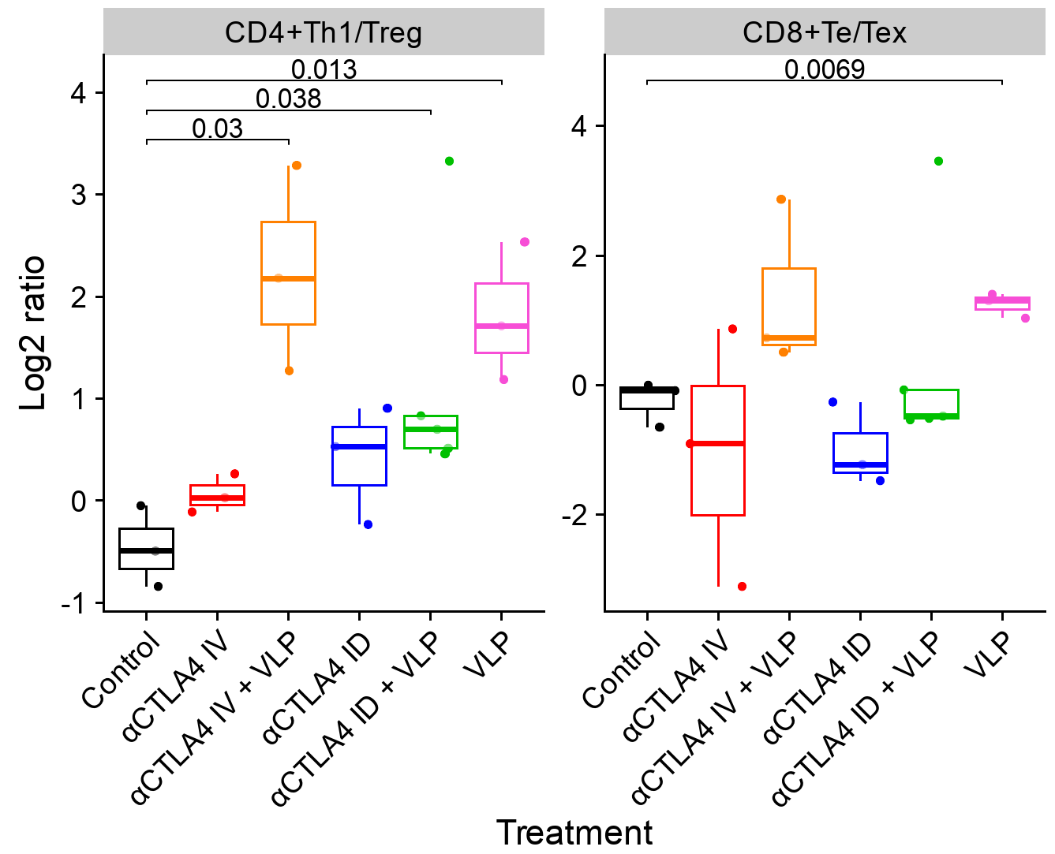
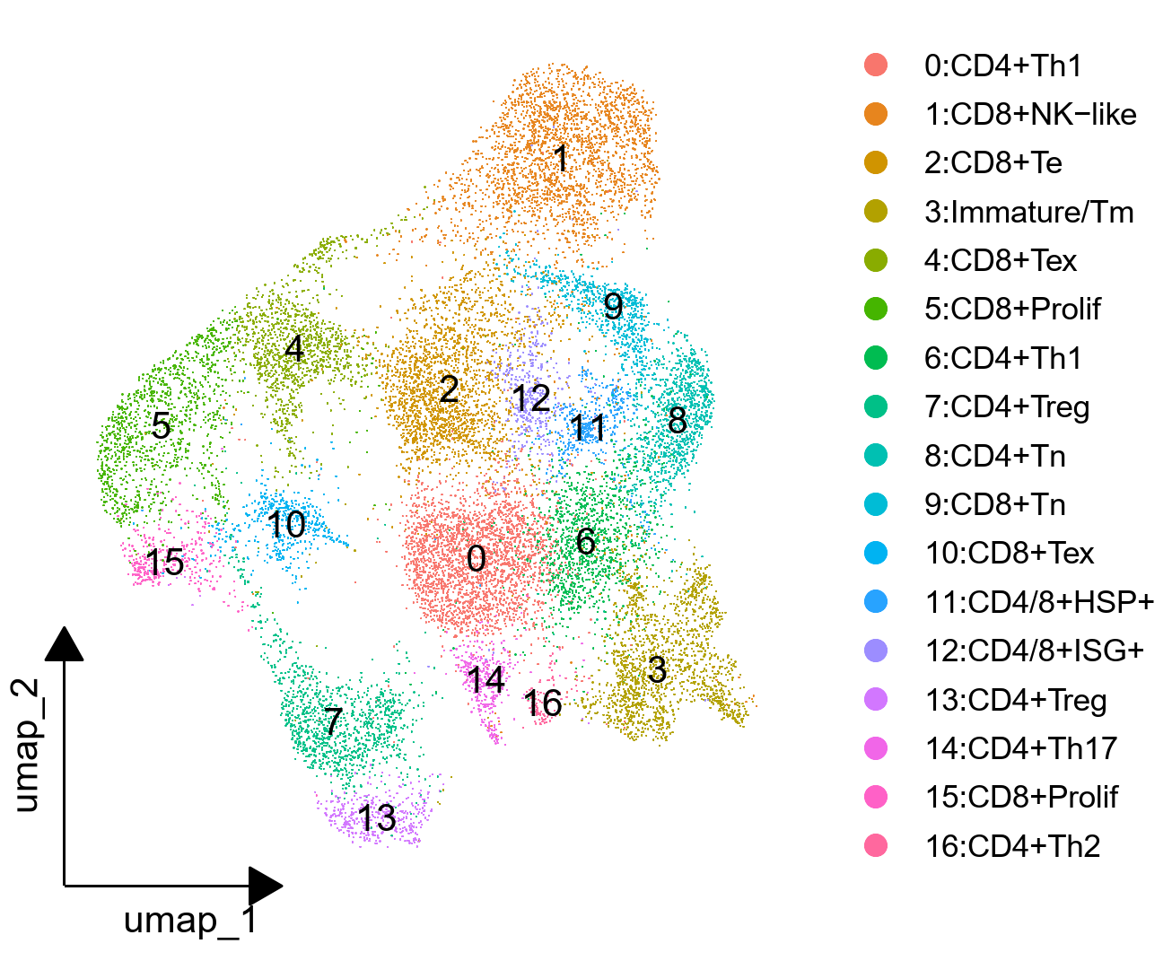
VLP vaccination increase effector T cells
Results
T cell subpopulations were annotated based on marker genes (scRNA-seq), and clonal expansion (scTCR-seq)
VLP vaccination increases CD4+ helper 1 T (Th1)/ regulatory T (Treg) ratio, and CD8+ effector T (Te)/ exhausted T (Tex) ratio, suggesting increase cell-mediated response
Validated using flow cytometry
Flow cytometry
scRNA-seq

Slide 8
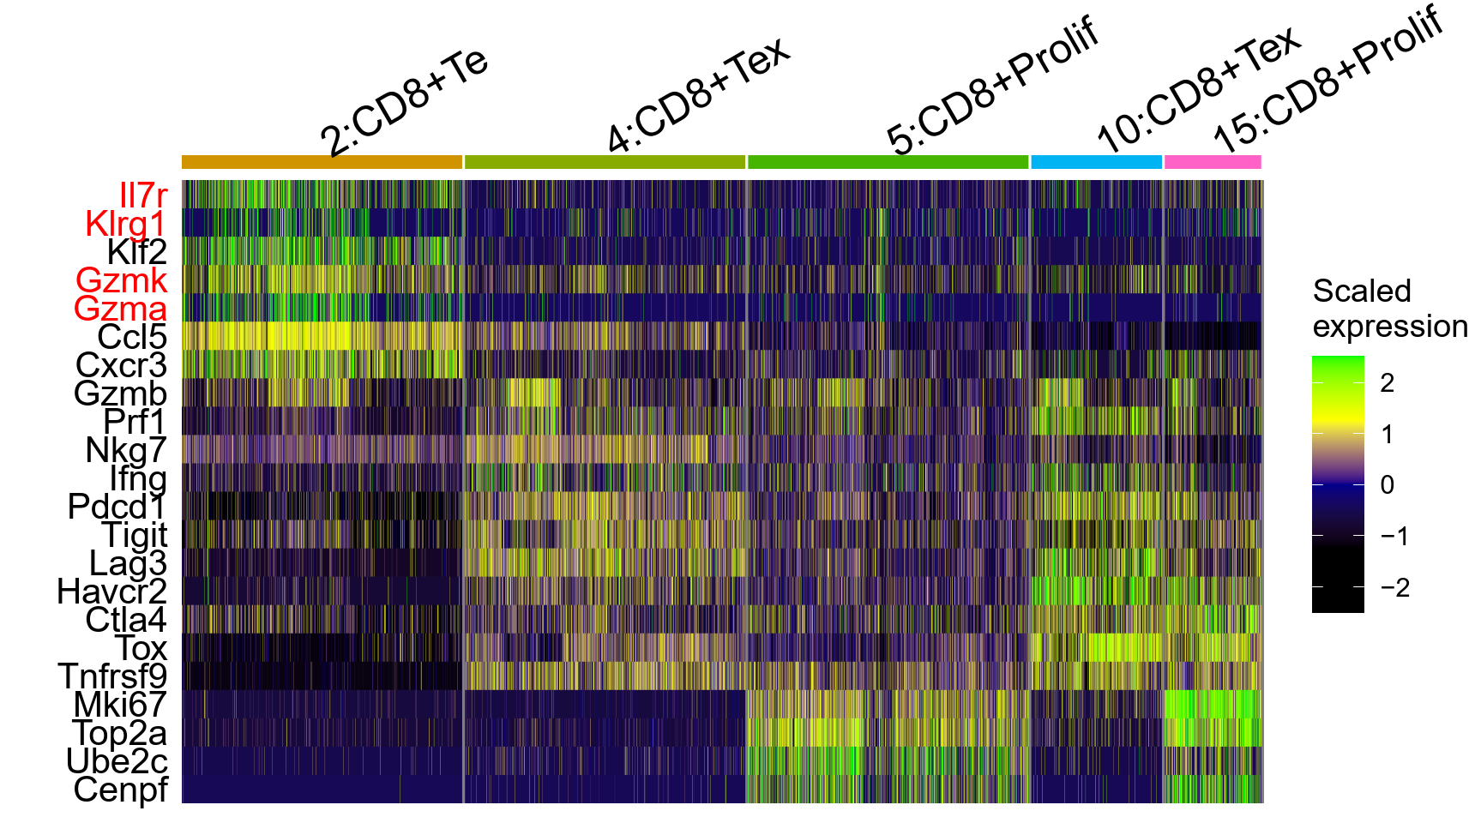
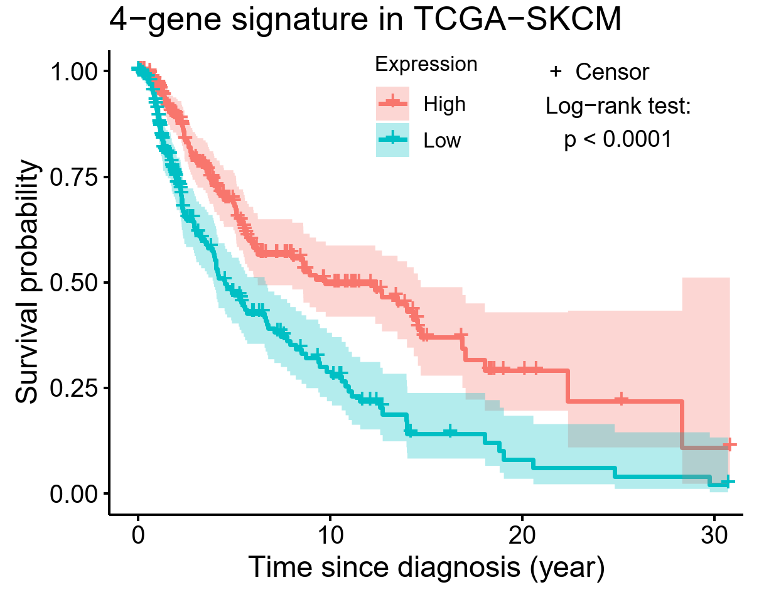
Klrg1+ effector T cells have anti-tumor effect
Results
CD8+ Te cells highly express Il7r, Klrg1, Gzmk, Gzma
May differentiate into "ExKLRG1" memory T cells with increased cytotoxicity and proliferative capacity
CD8+ Te signature positively correlated with patient survival in TCGA-SKCM
Herndle-Brandstetter et al. Immunity 2018

Slide 9
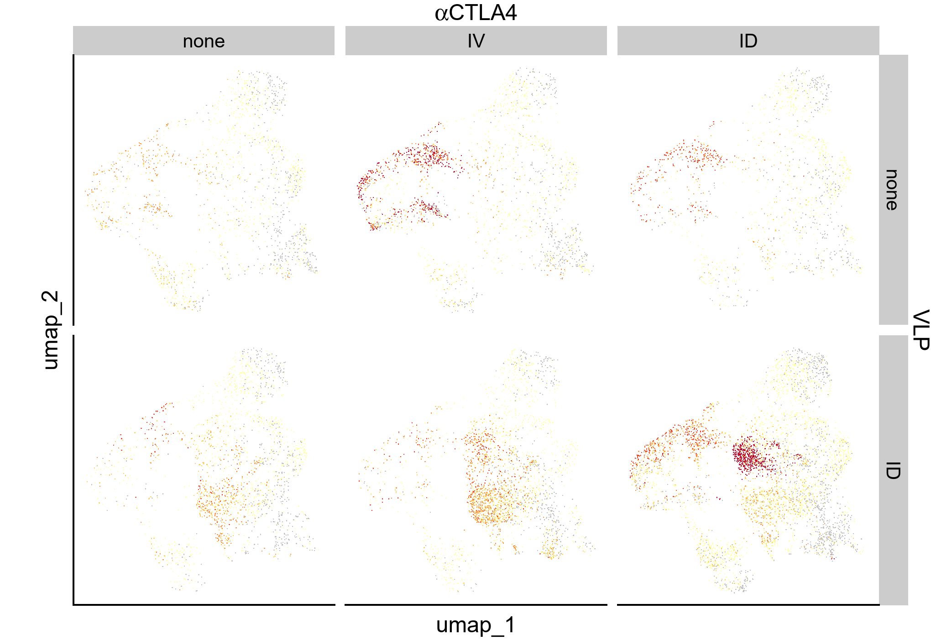
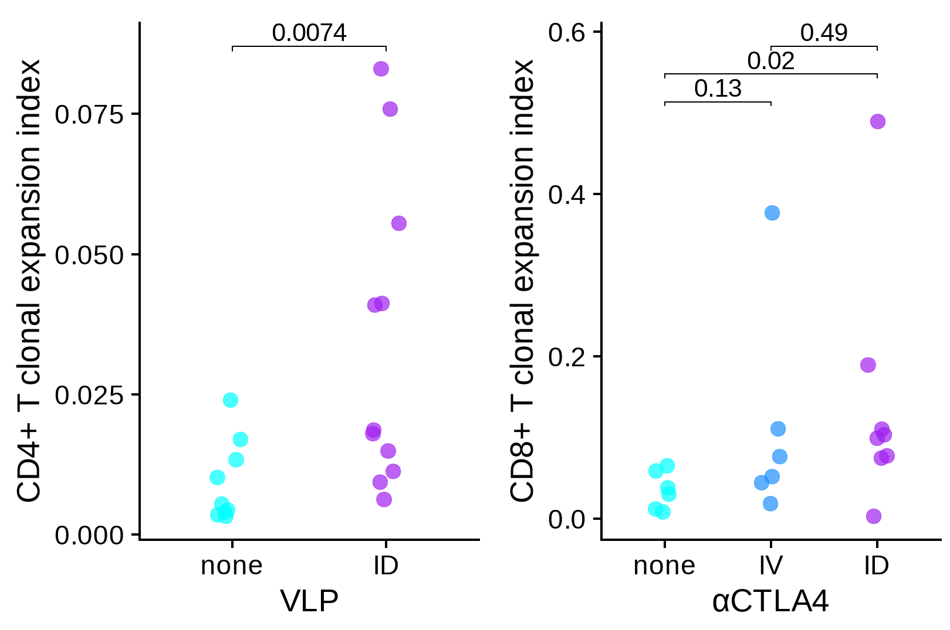
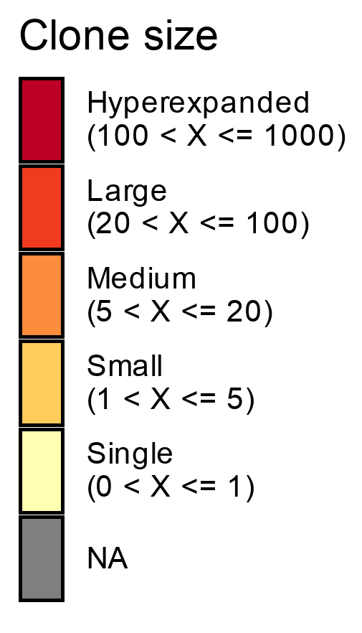
Treatments increase T cell clonal expansion
Results
Clonal expansion: T cells become activated after recognizing target antigen and divide into many T cells with same T cell receptor (TCR)
VLP vaccination significantly increases CD4+ T cell clonal expansion
αCTLA4 treatment significantly increases CD8+ T cell clonal expansion
CD8+ Tex & Proliferative
CD8+ Te
CD4+ Th1

Slide 10
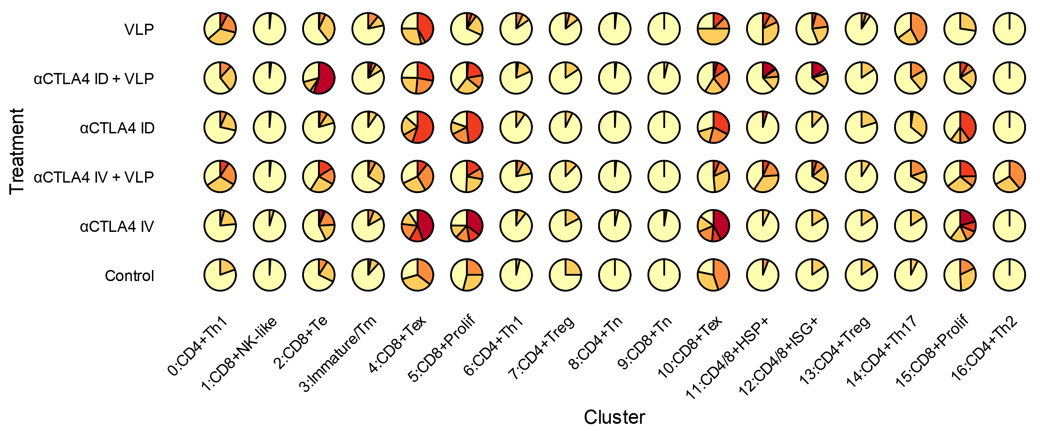
VLP increases CD4+ and CD8+ effector T cell clonal expansion
Results
With VLP vaccination: increased clonal expansion of Th1, Te, HSP+, ISG+
Without vaccination: increased clonal expansion of Tex, Proliferative T
Combination therapy effectively promoted the expansion of non-exhausted effector T cells

Slide 11
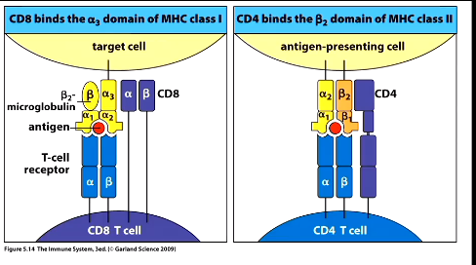
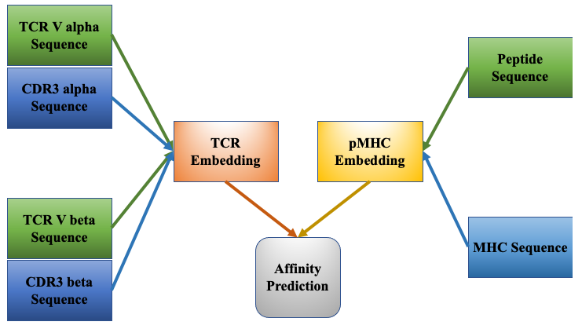
Tumor antigen-specific T cell prediction
Results
T cells recognize target cells through TCR-epitope-MHC binding
pMTnet-omni predicts TCR-epitope-MHC binding using amino acid sequence
In our study, we predicted vaccine peptide (PMEL)-specific TCRs
Han Y et al. bioRxiv 2023

Slide 12
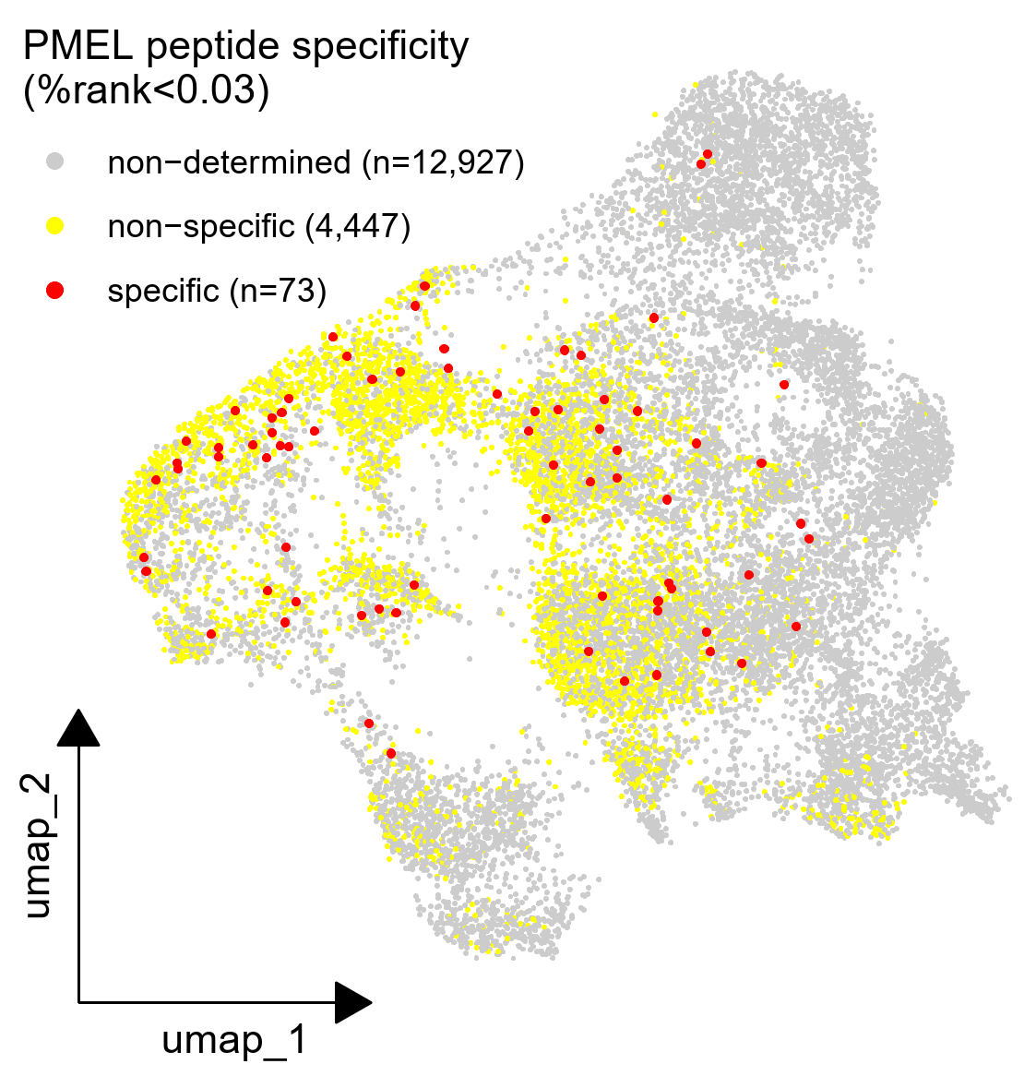
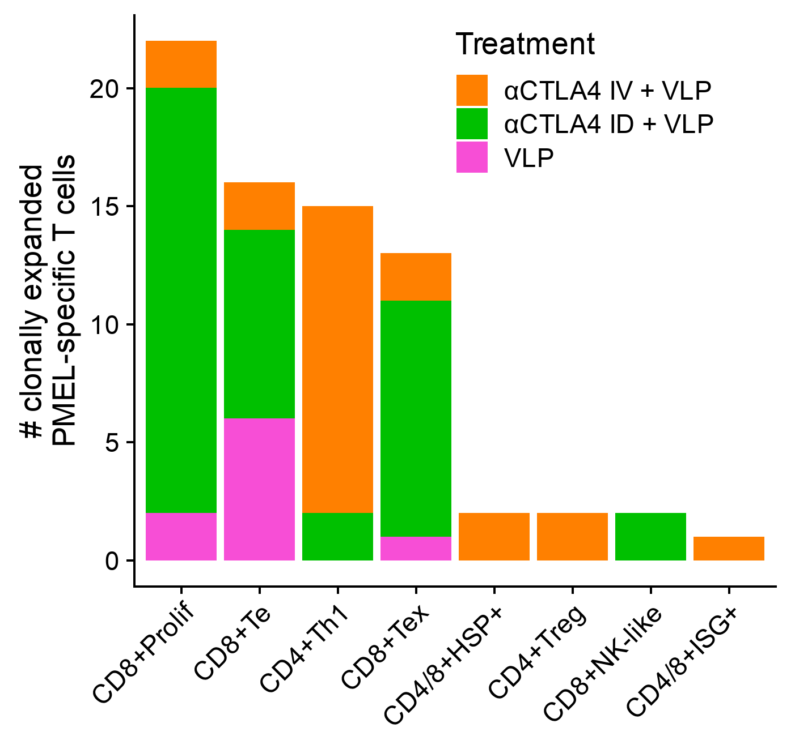
Tumor antigen-specific T cell phenotype
Results
High-binding-specificity T cells were selected by:
Clonal expansion;
Highly confident pMTnet-omni prediction (%rank<0.03)
Mainly in CD8+ Proliferative, Te, Tex and CD4+ Th1 clusters

Slide 13
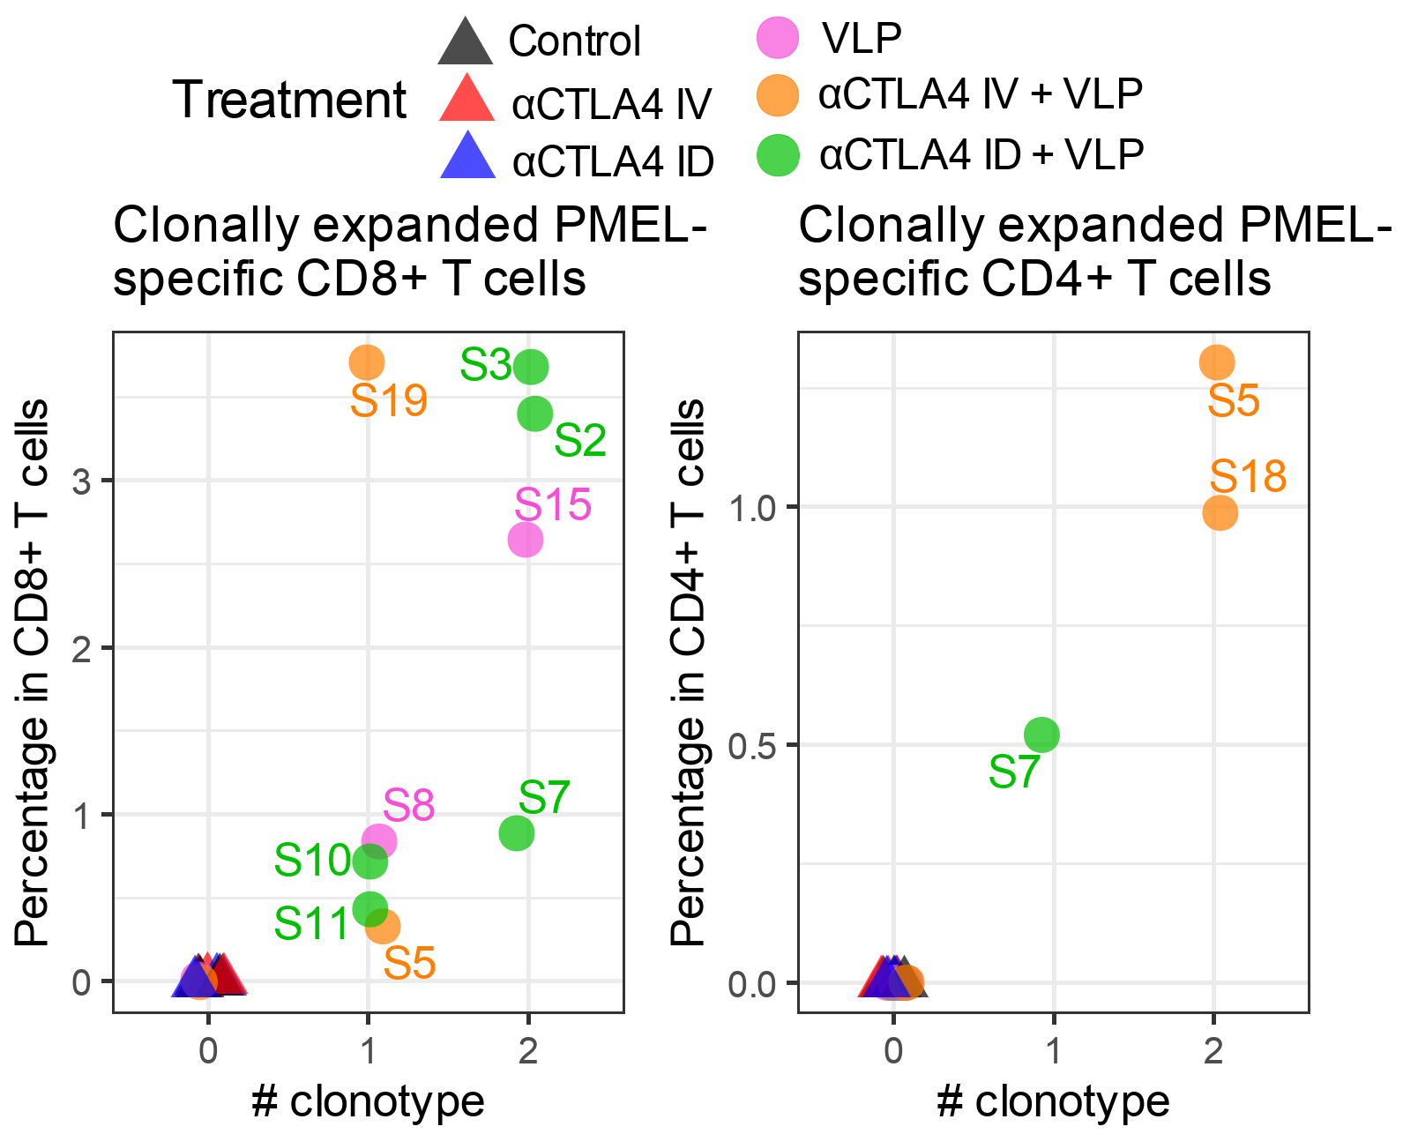
Tumor antigen-specific T cells in treatments
Results
Vaccine antigen (PMEL)-highly-specific T cells were found in almost all VLP-vaccinated mice, but none in unvaccinated mice
Accounting for 0.3%~4% CD8+/CD4+ T cells
Stronger response in CD8+ T cells likely because vaccine antigen is good MHC-I binder but not good MHC-II binder

Slide 14
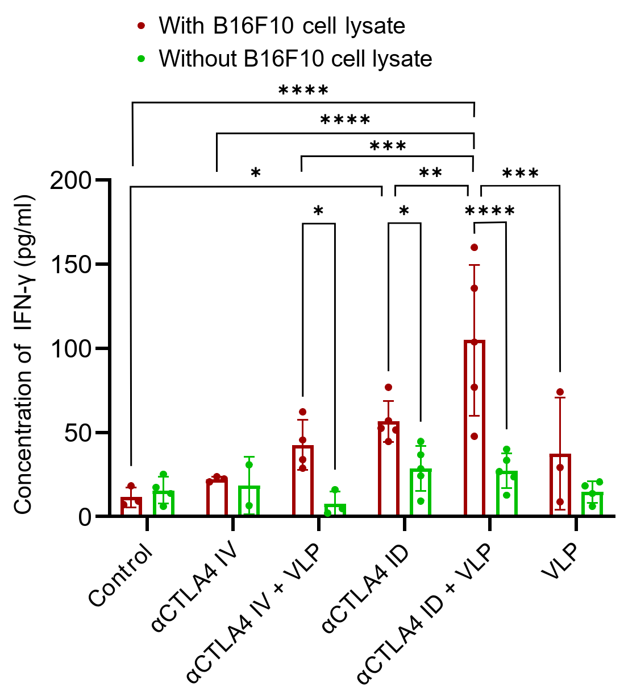
Tumor antigen-specific T cells in treatments
Results
ELISA experiment to measure overall tumor antigen-specific T cell level
Tumor-infiltrating T cells cocultured with tumor cell lysate (containing antigens) and bone marrow-derived DC
Higher IFN-γ concentration in treatment groups except αCTLA4 IV indicates more tumor antigen-specific T cells (some are not vaccine peptide-specific)

Slide 15
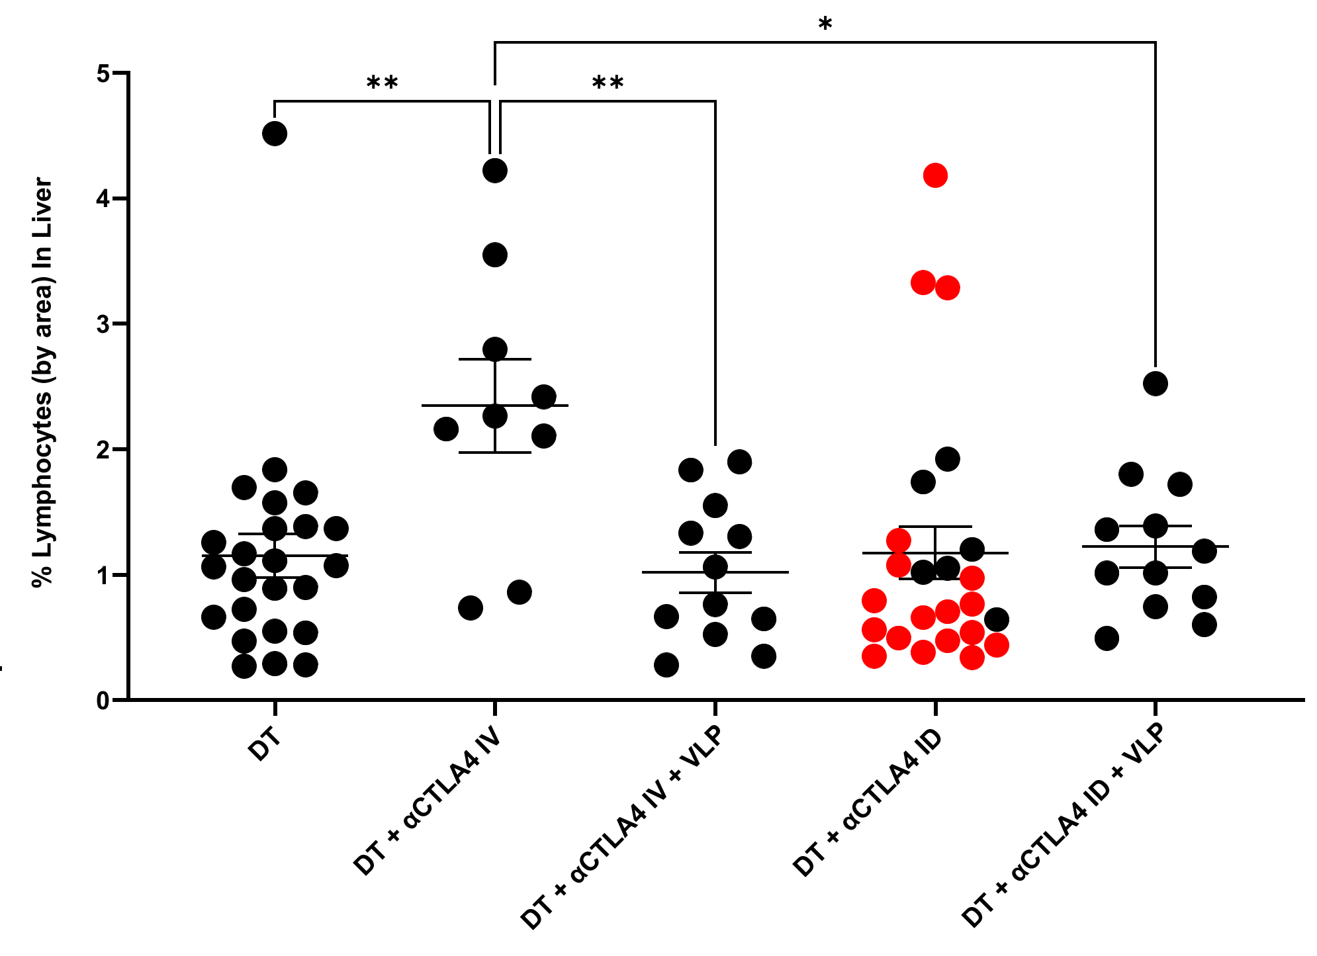
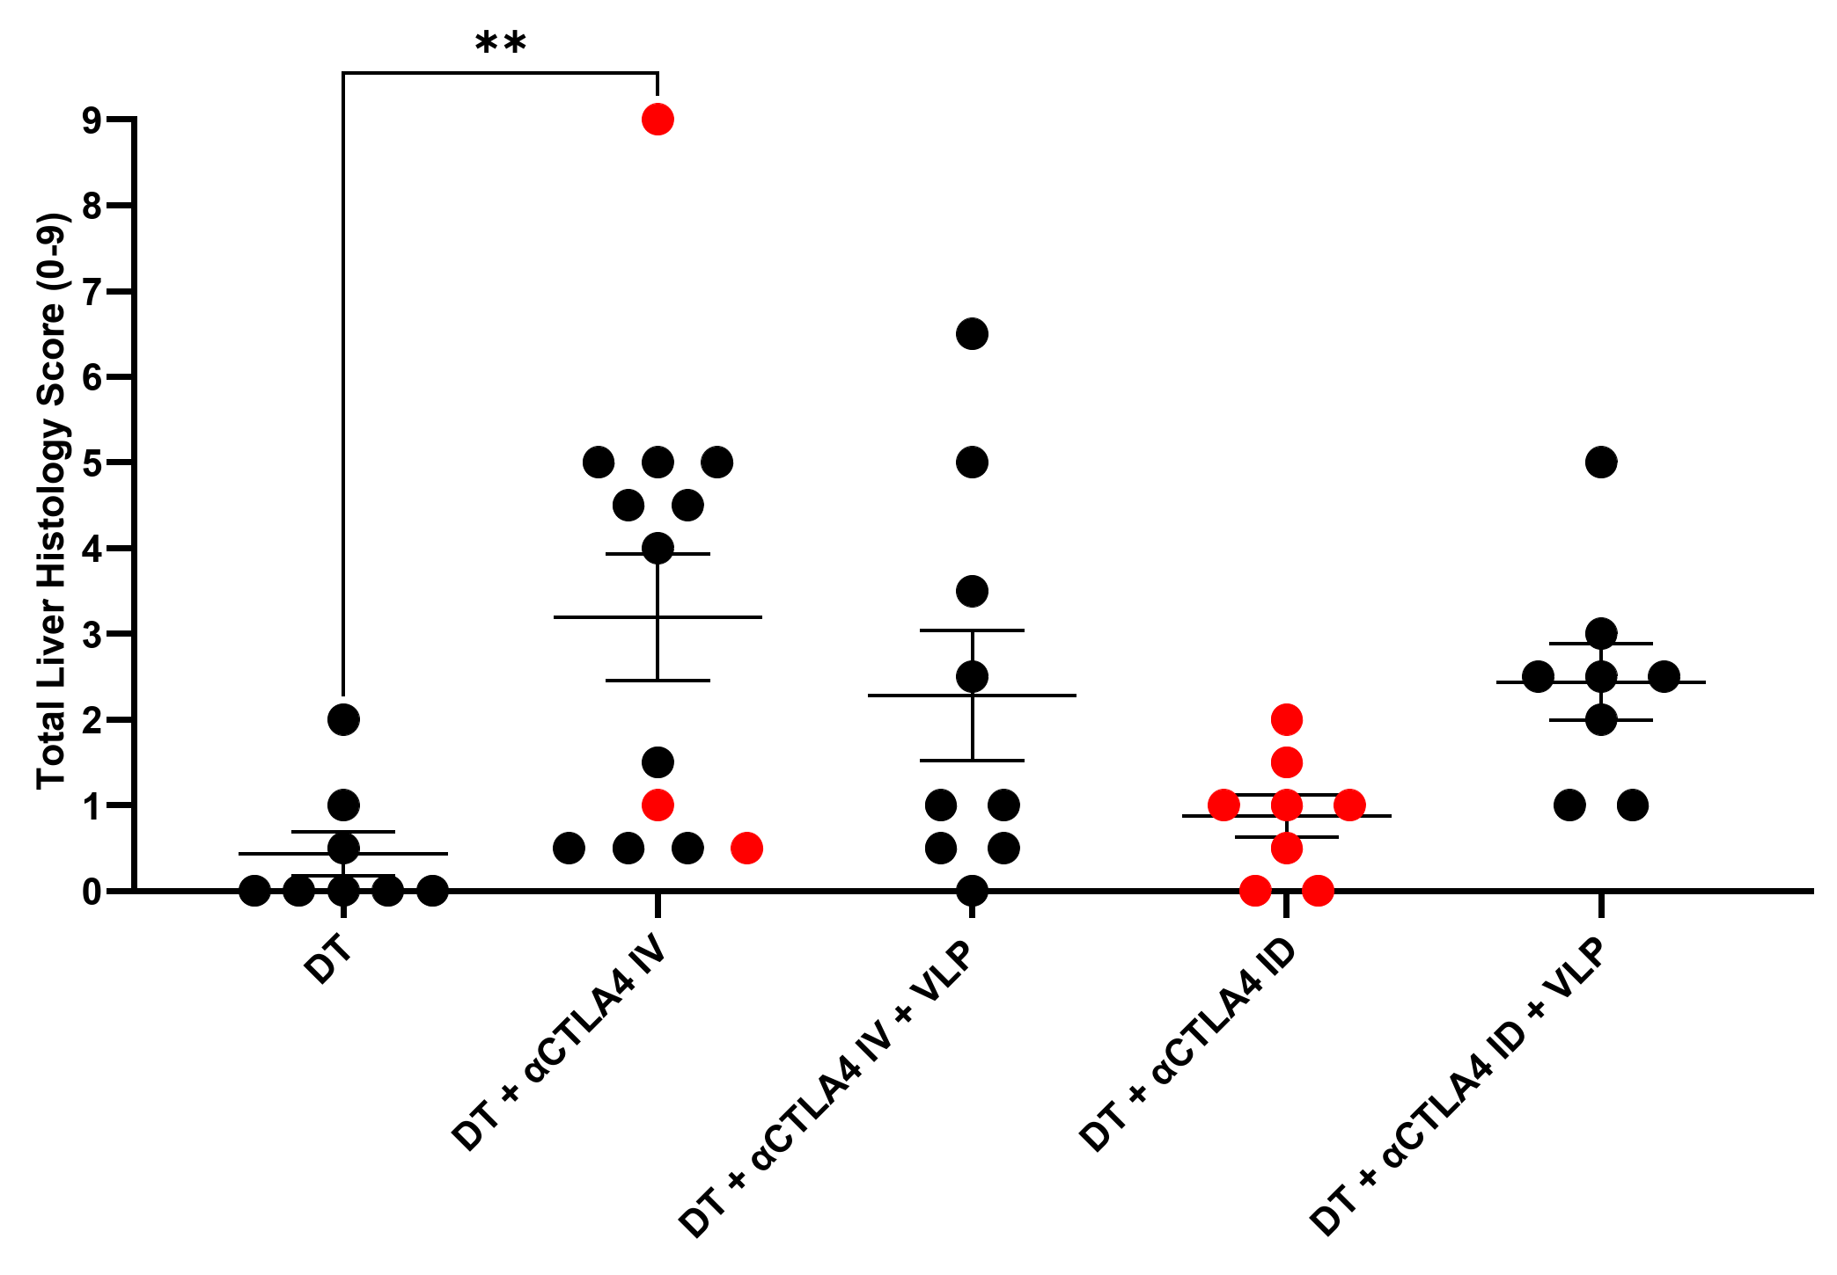

irAE assessment in mouse model
Results
Lymphocyte infiltration in liver
Foxp3-DTR (diphtheria toxin receptor) mice, Tregs depleted using diphtheria toxin
Measuring irAEs: lymphocyte infiltrating and inflammation in liver, lung and colon
Lower level of irAEs in αCTLA4 ID (lymphatic delivery) treatment compared to αCTLA4 IV (blood delivery)
Inflammation in liver

Slide 16
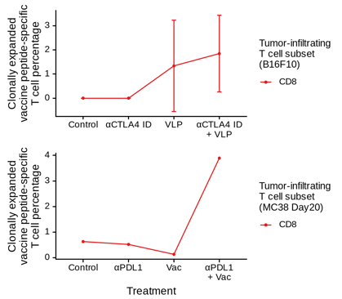
VLP is more immunogenic than peptide-based vaccine
Results
Comparative analysis between
MC38 colon cancer mouse model treated with tumor peptide vaccine (GSE178881)
B16F10 melanoma mouse model treated with VLP (ours)
VLP is more effective than peptide-based vaccine
Inducing vaccine peptide-specific T cell without immune checkpoint blockade
Inducing CD4+ Th1 cell clonal expansion
VLP
Peptide-based vaccine
Liu L et al. Nat Cancer 2022

Slide 17
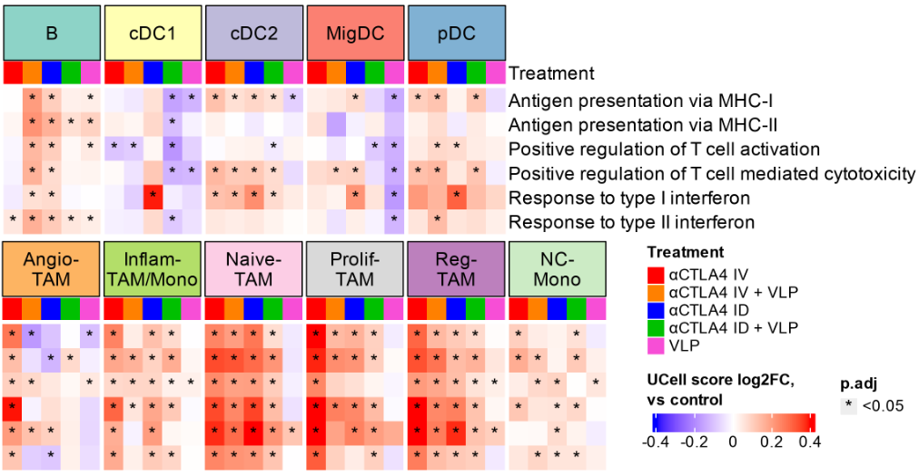
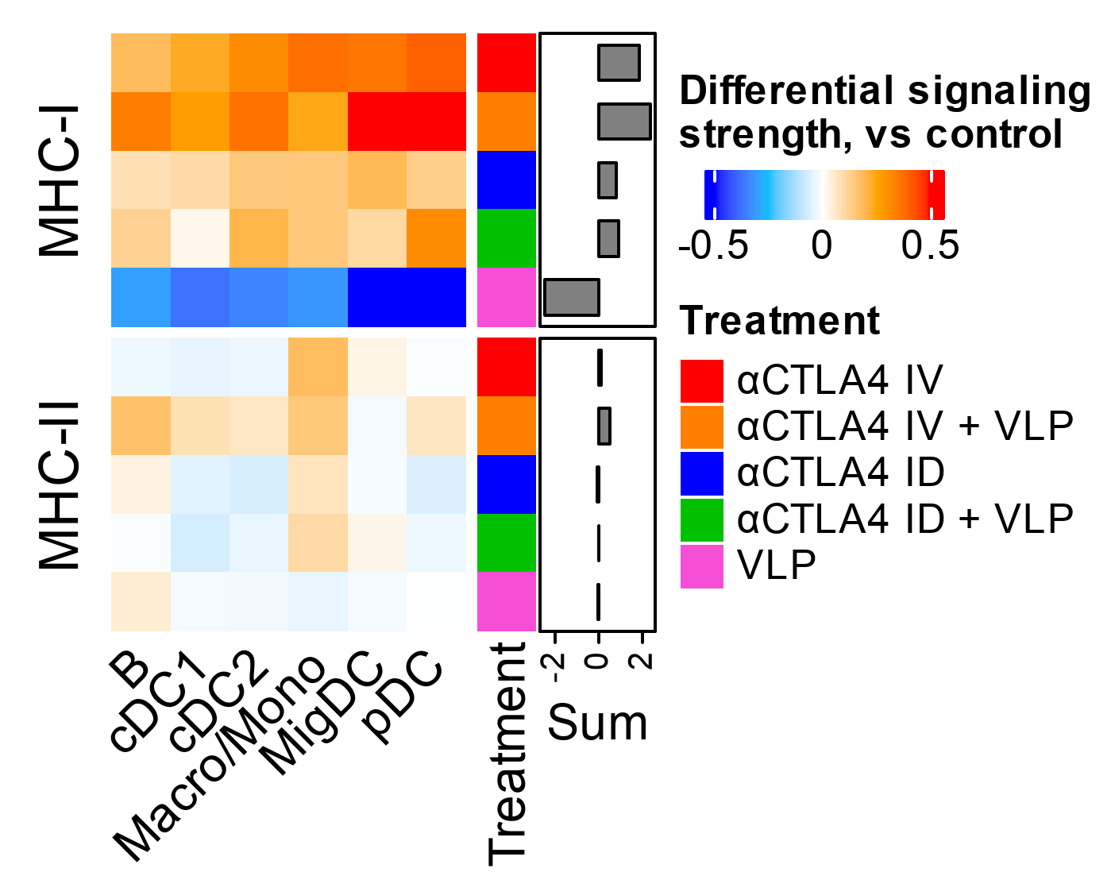
αCTLA4 increase APC activation
Results
Antigen-presenting cell (APC) populations were activated by αCTLA4 treatment but not VLP vaccination:
Increased antigen presentation and MHC signaling
Increased positive regulation of T cell response
Increased response to interferons

Slide 18
Summary
VLP vaccination combined with αCTLA4 lymphatic delivery is effective to induce potent anti-tumor immune responses.
It enhances complementary CD8+ and CD4+ T cell priming, effector T cell infiltration, tumor-specific responses, and durable immune memory that are critical for long-term tumor control.
Compared to regular blood delivery, the lymphatic delivery of αCTLA4 reduces immune-related adverse events and contributes to improved anti-tumor response.
We anticipate that directing vaccination and immune checkpoint inhibitor to non-tumor draining lymph node could improve clinical outcomes in cancer patients.

Slide 19


Acknowledgement
Collaborators:
UTHealth Houston
Eva Sevick
Zhongming Zhao
Sarat Kumar Kottarath
David Wiggins
Fred Christian Velasquez
University of Bern
Mona O. Mohsen
Arnau Solé Casaramona
Martin F. Bachmann
Baylor College of Medicine
Songlin Zhang
MD Anderson Cancer Center
Tao Wang
Yi Han
Grants:
R21CA267263
R01CA276513
R01LM012806
CPRIT RP190019
CPRIT RP240610
Fellowships:
John and Rebekah Harper Fellowship in Biomedical Sciences
CPRIT BIG-TCR Predoctoral Fellowship

Slide 20
Thanks for your attention!

Slide 21
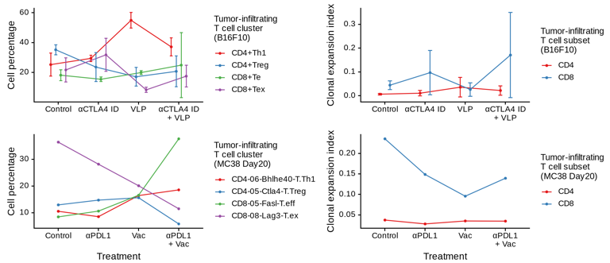

Slide 22
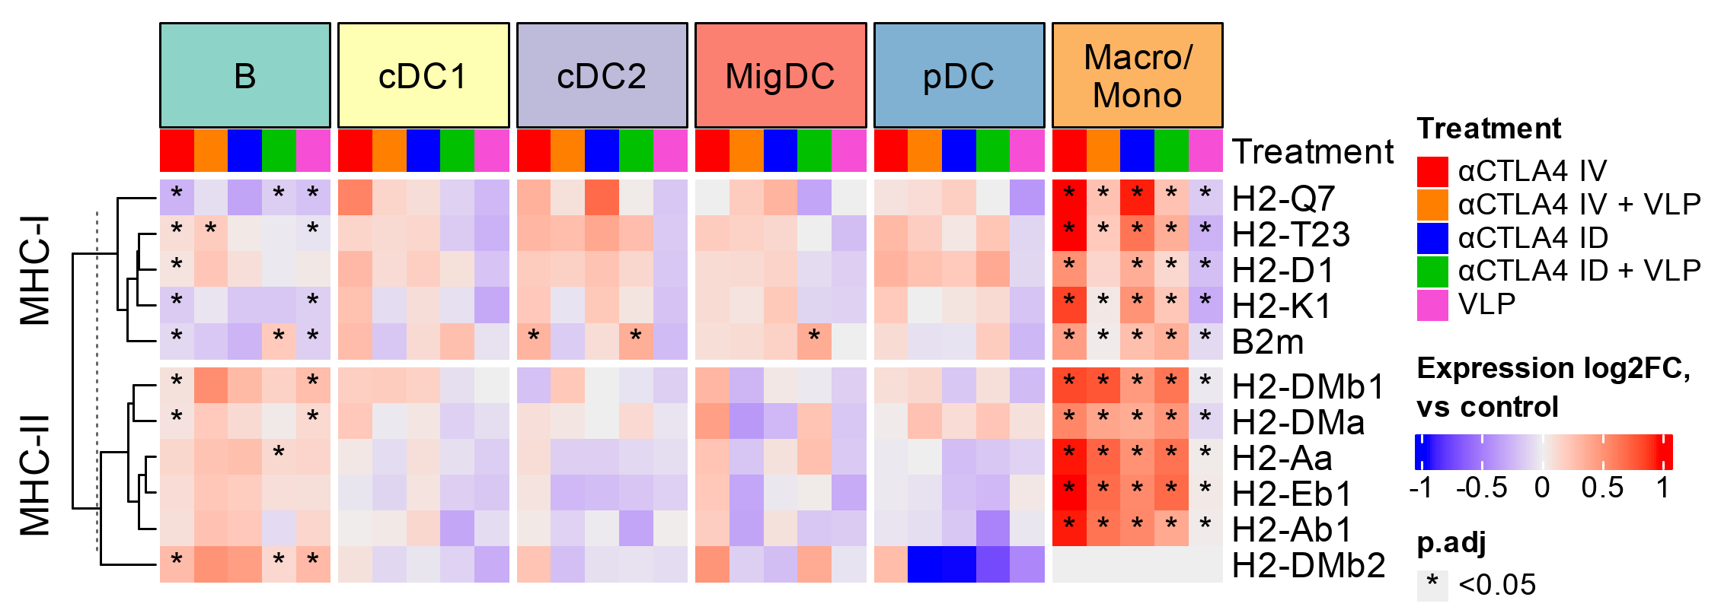
αCTLA4 increase MHC signaling
Results

Slide 23
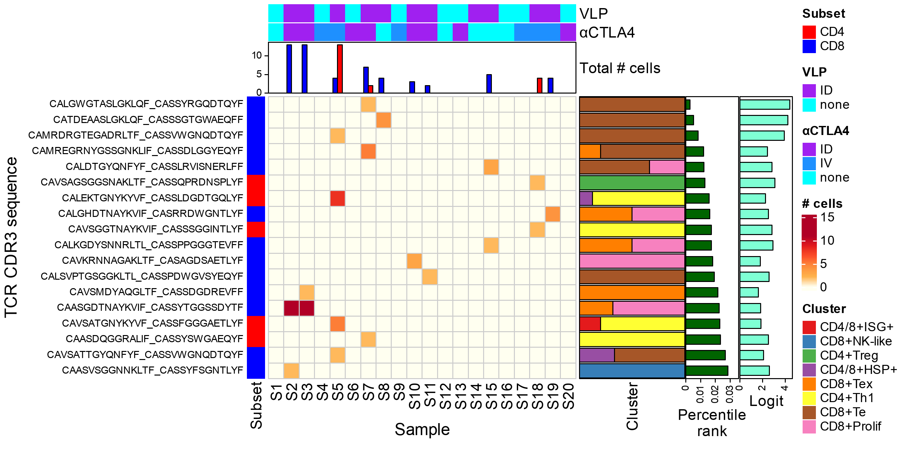

Slide 24
